Slide 1

Climate change and the carbon cycle

Slide 2

The carbon cycle:
The process that moves carbon between plants, animals, and microbes; minerals in the earth; and the atmosphere.

Slide 3
Climate change:
Long-term shifts in temperatures and weather patterns.

Slide 4
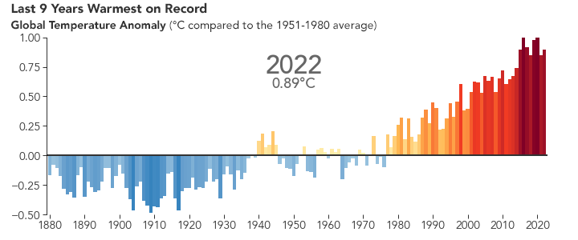
Notes:
The average temperature of the Earth’s surface is now about 1.1°C warmer than it was in the late 1800s (before the industrial revolution) and warmer than at any time in the last 100,000 years.

